Slide 1
ABAP on HANA

Slide 2
SAP HANA - Introduction
The concept of HANA was firstly introduced by Hasso Plattner who is the co-founder of SAP.
At that time, the full form of HANA was ‘Hasso’s New Architecture’.
Later from the marketing purpose, the full form is changed from Hasso’s New Architecture to ‘High-Performance Analytic Appliance’.
The full form of HANA has 3 parts - High-Performance , Analytic , Appliance.

Slide 3
SAP HANA - Introduction(Contd.)
High-Performance - This part emphasized on the speed of data processing.
Analytic - This part emphasized on complex and real time analysis.
Appliance - This part emphasized on combination of both hardware and software.
SAP HANA is a combination of both hardware and software.

Slide 4
SAP HANA - Introduction(Contd.)
The primary motivation behind SAP HANA was to address the limitations of traditional disk-based databases.
SAP recognized that traditional databases could not keep up with the increasing need of real-time data processing.
SAP HANA has in-memory database or in-memory computing.
An In-memory database means RAM. It means, data now resides in main-memory(RAM) also.

Slide 5
SAP HANA - Introduction(Contd.)
This in-memory computing helps to process large amount of data in real time.
Imp point : The difference between traditional databases and HANA database is - In traditional databases data resides in secondary memory(disk) whereas in HANA database data now resides in primary memory(RAM) also.

Slide 6
Core Concepts/Features of SAP HANA
The various core concepts or features of SAP HANA are as follows:
In-memory computing
Integration of OLAP and OLTP
Row and column storage
Data compression
Table Partitioning
Insert only on delta

Slide 7
Core Concepts/Features of SAP HANA Database(Contd.)
Simplified data models

Slide 8
Features - In Memory Computing
SAP HANA has in-memory database.
It means data is stored in the main memory(RAM) also.
This in-memory computing helps us to process large amount in data in real time.

Slide 9
Features - Integration of OLTP and OLAP
The traditional databases are suitable for OLTP only. They are not suitable for OLAP.
On the other hand, SAP HANA is designed to handle both OLTP and OLAP.
OLTP stands for Online Transaction Processing whereas OLAP stands for Online Analytical Processing. .
In case of OLTP the volume of data is less whereas in case of OLAP the volume of data is more.

Slide 10
Features - Integration of OLTP and OLAP(Contd.)
Example - Handling Day to day data for any business in an example of OLTP whereas consolidating the data for years and analyzing that data is an example of OLAP. ‘
In HANA, we can handle both OLTP and OLAP using single platform only.

Slide 11
Features - Row and Column Storage
There are primarily 2 ways to store the table data.
Row storage
Column storage
Row storage - In row storage, data is stored row wise.
Column storage - In column storage, data is stored column wise.
Traditional databases support only row storage.
SAP HANA supports both row storage and column storage.

Slide 12
Features - Row and Column Storage(Contd.)
As HANA database supports both row storage and column storage. Therefore, it is also called as hybrid database.
Path to specify the storage type for a table is as follows :
Technical Settings - DB-Specific Properties - Storage Type.
Refer to the attached excel to understand the row storage and column storage in the system.

Slide 13
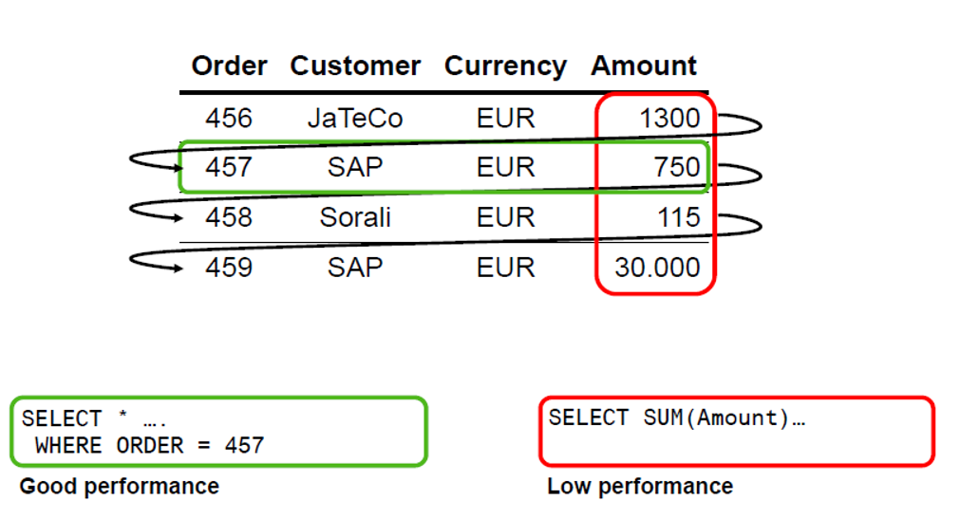
Features - Row and Column Storage(Contd.)
Row Storage

Slide 14
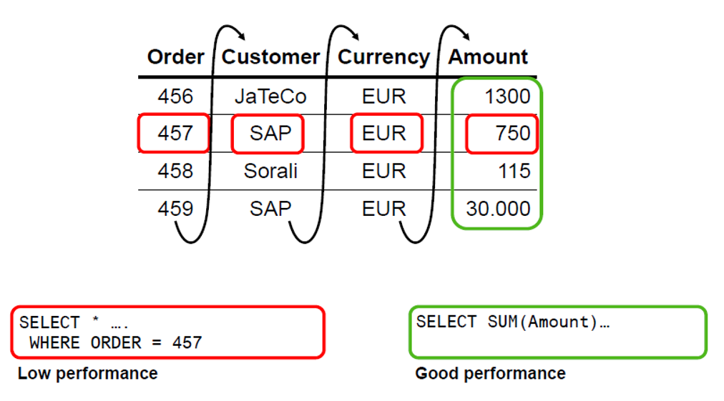
Features - Row and Column Storage(Contd.)
Column Storage

Slide 15
Features - Row and Column Storage(Contd.)
When to use row storage:
In the SQL statement, We need to access a complete row or record.
No aggregate functions and calculations are required on the table.
When to use column storage:
When the SQL statement has to perform aggregate functions and calculations.

Slide 16
Features - Row and Column Storage(Contd.)
The various advantages of row storage are as follows:
Efficient for small tables : Row storage is efficient for small tables when we want to access a complete row or record.
Faster transactions : The transactions(read, write etc.) are faster in row storage as we can access the complete record.

Slide 17
Features - Row and Column Storage(Contd.)
The various disadvantages of row storage are as follows:
More memory usage : Row storage occupies more memory as it has lower compression rates as compared to column storage.
Low performance for aggregate functions and calculations : Row storage provides low performance in case of aggregate functions and calculations.

Slide 18
Features - Row and Column Storage(Contd.)
The various advantages of column storage are as follows:
Less memory usage : In column storage, we can compress the data efficiently. This helps in reducing the memory usage significantly.
High performance for aggregate functions and calculations : Column storage provides high performance in case of aggregate functions and calculations.
Parallelization : Column storage simplifies parallel execution. Operations on different columns can be executed in parallel.

Slide 19
Features - Row and Column Storage(Contd.)
The various disadvantages of column storage are as follows:
Slower transactions : The transactions(read, write etc.) are slower in column storage as compared to row storage.

Slide 20
Features - Data Compression
Data compression is one of the important key feature of SAP HANA.
Data compression allows the HANA database to store large amount of data in main memory.
There is no manual process for data compression.
SAP HANA automatically do the compression using various data compression techniques.
The column storage allows the efficient compression of data.

Slide 21
Features - Data Compression(Contd.)
The default data compression method for column storage is ‘Dictionary Compression’.
Dictionary Compression : This default method of compression is applied to all columns. It involves the mapping of distinct column values to consecutive numbers, so that instead of the actual value being stored, the typically much smaller consecutive number is stored.

Slide 22
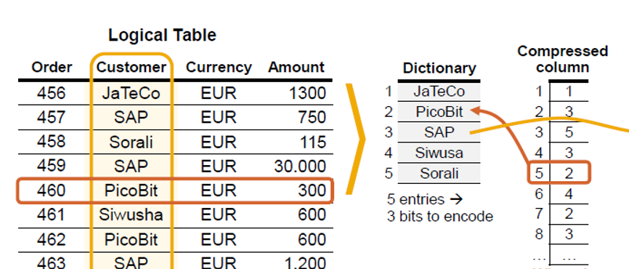
Features - Data Compression(Contd.)
Dictionary Compression

Slide 23
Features - Data Compression(Contd.)
The various advantages of data compression are as follows:
Allow to store large amount of data in main memory.
Reduces cost.
Reduces memory utilization.
Improves performance as compressed data transferred from main memory to CPU.

Slide 24
Features - Table Partitioning
Table partitioning is a data organization scheme in which table data is divided across multiple storage objects which is called as called data partitions.
The partitioning feature of the SAP HANA database splits column-store tables into sub-tables or partitions.
In this way, large tables can be broken down into smaller, more manageable parts.
When a table is partitioned, the split is done in such a way that each partition contains a different set of rows of the table.

Slide 25
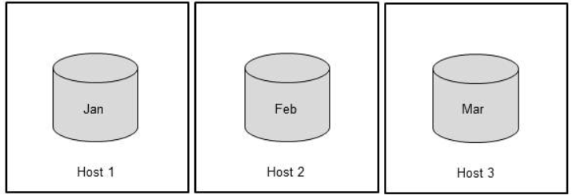
Features - Table Partitioning(Contd.)
Partitioning is typically used in multiple-host systems, but it may also be beneficial in single-host systems.
The following figure shows how a table data can be distributed over three hosts with dedicated partitions for individual months.
Example of Table Partitioning

Slide 26
Features - Table Partitioning(Contd.)
There are several strategies available for specifying how the rows are assigned to the partitions of a table.
The various table partitioning strategies are as follows:
HASH partitioning
ROUNDROBIN partitioning
RANGE partitioning

Slide 27
Features - Table Partitioning(Contd.)
HASH partitioning - In Hash partitioning, records are assigned to the partition based upon hash algorithm applied on the specified column.
Working : We define one or more columns as partitioning columns. SAP HANA applies a
hash function to the values of the specified partitioning columns. Based on the
calculated hash value and the total number of partitions defined, the system
determines which partition a particular row belongs to.

Slide 28
Features - Table Partitioning(Contd.)
ROUNDROBIN partitioning - It is called as round robin partitioning because the system rotates through all the partitions. In roundrobin partitioning, records are assigned in a round robin manner to the available partitions. There is no need to specify any partitioning column. With round-robin partitioning, new rows are assigned to partitions on a rotation basis.

Slide 29
Features - Table Partitioning(Contd.)
Range partitioning - Records are assigned to the partitions using defined ranges. Example - Records having company code value 1000-2000 belongs to one partition. Records having company code value 2001-3000 belongs to another partition.

Slide 30
Features - Table Partitioning(Contd.)
When to use HASH partitioning:
When a table has large number of records and we want to look up for the data, based upon partition column. In that case it directly searches in the correct partition without scanning all the partitions.
When to use ROUNDROBIN partitioning:
When we want to distribute the load as even as possible across all the partitions as in ROUNDROBIN partitioning, system rotates through all partitions.

Slide 31
Features - Table Partitioning(Contd.)
When to use RANGE partitioning:
When there is a need for logical grouping of data.

Slide 32
Features - Table Partitioning(Contd.)
The various advantages of partitioning are as follows:
Overcoming the size limitation of column-store tables : A non-partitioned table cannot store more than 2 billion rows. It is possible to overcome this limit by distributing the rows across several partitions. Each partition must not contain more than 2 billion rows.
Load balancing in a distributed system : Individual partitions can be distributed across multiple hosts. This means that a query on a table is not processed by a single server but by all the servers.

Slide 33
Features - Table Partitioning(Contd.)
Parallelization : Partitioning allows the various operations on the table to be parallelized.

Slide 34
Features - Insert only on Delta
This is another key feature of SAP HANA which is also called as ‘Insert only approach’.
In SAP HANA, for column storage tables, it only inserts the data.
It means, whether we go for update or delete data also, SAP HANA just inserts the data.
In SAP HANA, each column storage table has two distinct parts.
Main table(Main part) - The main table is read only and compressed.
Delta table(Delta part) - The delta table is for reflecting the changes made by DML operations like INSERT, UPDATE, DELETE and uncompressed.

Slide 35
Features - Insert only on Delta(Contd.)
One important terminology used in this whole process is called as delta merge process.
Delta merge process: It is also called as merge process. In this, system automatically merges the changes of delta table to main table.
The working of INSERT , UPDATE and DELETE statements are as follows:
INSERT : INSERT statement inserts a new record to the delta part. The delta merge process merges the changes of delta part to main part and the new record is inserted to main part.

Slide 36
Features - Insert only on Delta(Contd.)
UPDATE : An UPDATE statement inserts a new version of the record to the delta part and the old version of the record is marked as invalid in the delta part. The delta merge process merges the changes of delta part to main part and the new version of the record is available in main part. Old versions are deleted when there is no open transaction active for them.Therefore, update internally performs INSERT + DELETE.

Slide 37
Features - Insert only on Delta(Contd.)
DELETE : A DELETE statement select the records and mark it as invalid in the delta part. The delta merge process merges the changes of delta part to main part. Records are deleted when there is no open transaction active for them.

Slide 38
Features - Insert only on Delta(Contd.)
The reason or benefit behind insert only approach is as follows:
As the main table is compressed and changes to compressed data is more expensive. Example - For any DML operation, firstly we need to uncompress the data, make the changes and compress again. For this reason, data is only appended to the uncompressed delta table where the DML operations are much cheaper. Then the delta merge process merges the changes from delta part to main part.

Slide 39
Features - Simplified Data Models
Simplified data models is another key feature of SAP HANA which covers the redesigning of the structure of the data.
The simplified data model is achieved in SAP HANA by focusing on below aspects or points:
Merging of tables.
Avoidance of aggregate tables.

Slide 40
Features - Simplified Data Models(Contd.)
Merging of tables - In this aspect, SAP added the fields of one table into another table or created a new table and added the fields of multiple tables to that new table.
The various examples for the merging of tables as follows:
VBUK and VBUP Tables : The sales order status tables VBUK and VBUP are no longer in use in SAP S/4 HANA and the status fields has been added to VBAK and VBAP tables.

Slide 41
Features - Simplified Data Models(Contd.)
Introduction to MATDOC Table : The MATDOC(Material Documents) table in SAP S/4HANA is the central inventory table for all material movements. It replaces the older MKPF and MSEG tables. It helps in real time inventory reporting.
Introduction to ACDOCA Table : The ACDOCA(Universal Journal Entry Line Items) table in SAP S/4HANA consolidates all financial(FI), controlling(CO), asset data in to a single table. It replaces various tables like BSEG, COEP, ANEP etc. It helps in real time reporting.

Slide 42
Features - Simplified Data Models(Contd.)
Avoidance of aggregate tables - In this aspect, SAP strictly prohibited the creation and use of aggregate tables.
Traditional approach : This approach says that the data should be stored at whatever level is required by the application to ensure maximum performance.
HANA approach : This approach says that data should be stored at the highest possible level. All aggregates required by any application can now be computed from the source data on-the-fly.

Slide 43
Features - Simplified Data Models(Contd.)
Question : Why SAP has not deleted the tables in S/4 HANA system which are not in use?
Answer : It will create problems during migration from ECC to S/4 HANA. As the existing programs of ECC system will throw compilation error/runtime error in S/4 HANA system due to non-existent of tables. Therefore, SAP has not deleted those tables or provided the DDL SQL view with the same name.

Slide 44
HANA DB Architecture
SAP HANA database consists of multiple components.
The most important component of SAP HANA database is index server.
The various components of SAP HANA database are as follows:
Index server
Preprocessor server
Name server
Statistics server
Index server
Preprocessor server
Name server
Statistics server
SAP HANA database components

Slide 45
HANA DB Architecture - Index Server
Index Server is heart of SAP HANA database system.
All HANA processing takes place in index server.
It contains the actual data and the engines for processing the data.
When SQL or MDX(Multi-Dimensional Expressions) is fired for SAP HANA system, an index server takes care of all these requests and processes them.
MDX is a query language for OLAP systems like SQL is for relational database.

Slide 46
HANA DB Architecture - Preprocessor Server
Preprocessor server in SAP HANA system is used for text data analysis.
The index server uses the preprocessor server for analyzing text data and extracting the information from text data.

Slide 47
HANA DB Architecture - Name Server
Name server contains the information about the topology or landscape of the SAP HANA system.
In a distributed environment, name server manages the topology of all the distributed servers.
In a distributed environment, the name server knows where the components are running and which data is located on which server.

Slide 48
HANA DB Architecture - Statistics Server
Statistical server is responsible for collecting the data related to system resources, their allocation and consumption of the resources.
It also tells us about the overall performance of HANA system.
It also provides historical data related to system performance for analysis purpose. This analysis helps to check and fix performance related issues in HANA system.

Slide 49
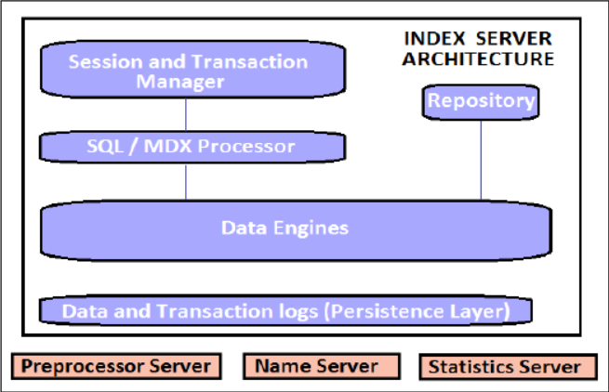
HANA DB Architecture - Components of Index Server
The various components of index server are as follows:
Session and transaction manager
SQL/MDX processor
Data engines
Repository
Persistence layer
Components of Index Server

Slide 50
Components of Index Server - Session and Transaction Manager
Session manager is also called as connection and session manager.
The session manager is responsible for initializing, managing the connections and the sessions between the client applications and the HANA database.
The transaction manager is responsible to coordinate all database transactions.
Transaction manager keeps track of running and closed transactions.
When a transaction is executed or failed, transaction manager notifies relevant data engine to take necessary actions.

Slide 51
Components of Index Server - SQL/MDX Processor
The SQL/MDX processor is responsible to process all SQL and MDX queries.
SQL is a query language for relational database whereas MDX is a query language for OLAP systems.
It direct the requests to data engine which fetches data as per the user requirement.

Slide 52
Components of Index Server - Data Engines
Data engines receive the request from SQL/MDX processor
It fetches data as per the user requirement from the in-memory database or repository.

Slide 53
Components of Index Server - Repository
It contains the actual data.
Data engines fetch the data from the repository as per the user requirement.

Slide 54
Components of Index Server - Persistence Layer
The persistence layer is responsible for durability and atomicity of transactions.
Persistence layer provides built in disaster recovery system for HANA database.
It ensures database is restored to most recent state and ensures that all the transactions are completed or undone in case of a system failure or restart.
It contains the data backup, log backup of the HANA system.

Slide 55
Programming Approaches - Data-to-Code Vs. Code-to-Data
There are 2 programming approaches or styles or paradigm in ABAP.
Data-to-Code
Code-to-Data

Slide 56
Programming Approaches - Data-to-Code Vs. Code-to-Data(Contd.)
Data-to-Code:
It is a classical approach or traditional approach of programming .
In this programming approach, we bring all the required data on the application layer.
Then we perform computations and calculations with that data on the application layer.
Example - Suppose we want to calculate sum of amount column, then we firstly bring the required data on the application layer and then apply the various statements like COLLECT to calculate sum of amount values.

Slide 57
Programming Approaches - Data-to-Code Vs. Code-to-Data(Contd.)
Code-to-Data:
It is a new programming approach.
It is also called as ‘Code Pushdown’ approach.
In this programming approach, we write the code to push down data intensive calculations and computations to the HANA DB layer.
Only results are transferred to the application layer.

Slide 58
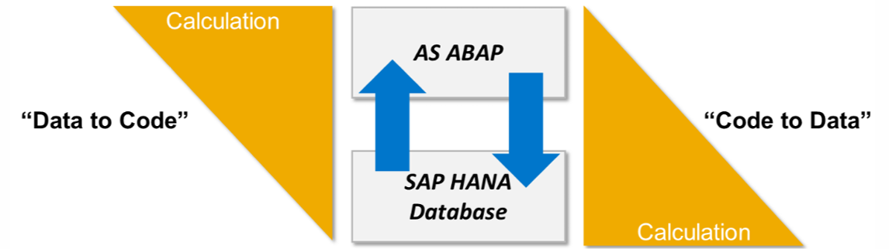
Programming Approaches - Data-to-Code Vs. Code-to-Data(Contd.)
Example - Suppose we want to calculate sum of amount column, then in the open SQL query itself, we use the SUM function and brings the calculated sum on the application layer.
Data-to-Code Vs. Code-to-Data

Slide 59
Programming Approaches - Data-to-Code Vs. Code-to-Data(Contd.)
Imp point : To develop applications in ABAP for HANA, we use Code-to-Data approach. Open SQL enhancements, CDS views, AMDP follows Code-to-Data approach.

Slide 60
HANA Approaches - Save Data to Disk
Question : HANA means In-memory. In-memory means RAM. We all know, RAM is volatile temporary memory. Does it mean all data would be lost when power goes down or there is reboot or there is hard or soft failure?
Answer : To ensure data is not lost in case of a power failure or system crash, SAP HANA uses these 2 approaches to write data to the disk.
Save data at regular savepoints - Data is automatically saved from memory to disk(data volume) at regular intervals.

Slide 61
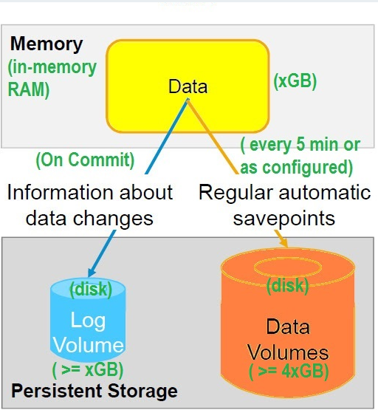
HANA Approaches - Save Data to Disk(Contd.)
Save data changes on commit - All data changes are saved from memory to disk(log volume) for each committed database transaction.
Saving data to Disk
Notes:
s

Slide 62
Comparison of ECC , SOH and S4H Systems
Refer to the attached sheet for the detailed comparison of ECC , SOH and S4H systems.

Slide 63
Eclipse - Introduction
Previously, we do everything using SAP GUI.
For HANA database, SAP did the major changes at the hardware and software sides , so to keep pace with hardware and software innovations, eclipse is introduced.
It provides an eclipse-based IDE( Integrated Development Environment) or eclipse-based work environment.
It provides tools to do the administration, monitoring and configuration of SAP systems.

Slide 64
Eclipse - Introduction(Contd.)
Therefore, eclipse is used as both - the central development environment and the main administration tool for SAP systems.
Also, the eclipse gives freshness to developers who were bored with the blue GUI screen editor and now the developers prefer to use eclipse as user interface.

Slide 65
Eclipse - ADT - Introduction
ADT stands for ABAP Development Tools.
ADT provides eclipse-based ABAP IDE(Integrated Development Environment).
ADT does not come by default.
It has to be installed as a plugin on eclipse.

Slide 66
Eclipse - ADT - Installation Steps
In eclipse, choose in the menu bar help-install new software.
Enter the URL - https://tools.hana.ondemand.com/latest
Press enter to display the available features.
Select ABAP development tools and choose next.
On the next wizard page, you get an overview of the features to be installed. Choose next.
Confirm the license agreements and choose finish to start the installation.

Slide 67
Eclipse - Perspective - Introduction
In layman’s term, perspectives are predefined layouts for different roles.
For example - we have ABAP perspective for ABAP developers. Java perspective for Java developers. Debug perspective for debugging.
Path to open the perspective: Window - perspective - open perspective - other

Slide 68
Eclipse - ABAP Project - Introduction
ABAP project connects eclipse to ABAP system.
ABAP project helps to connect eclipse-based ABAP IDE to ABAP backend system.
We can connect to different ABAP systems from single eclipse user interface.

Slide 69
Eclipse Editor - Functionalities
Save - Ctrl + S
Syntax check - Ctrl + F2
Activation - Ctrl + F3
Run - F8
Activate all inactive objects - Ctrl + Shift + F3
Open ABAP development object - Ctrl + Shift + A
Open SAP GUI - Ctrl + 6

Slide 70
Eclipse Editor - Functionalities(Contd.)
Where used list - Ctrl + Shift + G
Zoom in - Ctrl + =
Zoom out - Ctrl + -
Go to line - Ctrl + L
Insert/overwrite

Slide 71
Eclipse Editor - Pretty Printer Functionality
The use of pretty printer is used to format the ABAP code. It makes the code more readable.
There is no separate icon for pretty printer.
The shortcut of pretty printer is Shift + F1.
The various functionalities of pretty printer are as follows:
Indentation
Convert uppercase/lowercase

Slide 72
Eclipse Editor - Pretty Printer Functionality(Contd.)
The path to choose ABAP formatter settings is as follows :
Window - Preferences - ABAP Development - Editors - Source Code Editors - ABAP Formatter

Slide 73
Eclipse Editor - Comments Functionality
A comment is an explanation that is added to the source code of a program to help the person reading the program to understand it.
Comments are ignored when the program is generated by the ABAP compiler.
The * character at the start of a program line indicates that the entire line is a comment.
The " character, which can be entered at any position in the line, indicates that the remaining content in the line is a comment.

Slide 74
Eclipse Editor - Comments Functionality(Contd.)
Comment out lines - Ctrl + <
Uncomment lines - Ctrl + >
Toggle comment - Ctrl + 7

Slide 75
Eclipse Editor - Code Completion Functionality
This is one of the widely used functionality/feature that speeds up the coding.
The shortcut for the same is Ctrl + space.
It helps in code completion by following ways.
Keyword completion.
Code templates for completion.
Content assist to suggest completion for variable names, method names.

Slide 76
Eclipse Editor - Quick Fix Functionality
Quick fix allows us to quickly resolve the errors and warnings in the source code through the corresponding functionality that is provided in the quick fix popup.
Quick fixes are used to make typing much faster.
You can apply quick fix through Edit-quick fix or using the shortcut Ctrl + 1 .
The various usage of quick fix are as follows:
Class implementation from class definition.
Method implementation from method definition.

Slide 77
Eclipse Editor - Quick Fix Functionality(Contd.)
Method definition from method implementation.
Creating implementation for interface methods.
Creating method definition from method calls.
Creating ABAP classes and ABAP interfaces from the source code.
Creating ABAP Includes from source code.
Creating ABAP Function Modules from source code.

Slide 78
Eclipse Editor - Various Help
The various help in source code editor of eclipse are as follows:
ABAP keyword documentation - F1
Show code element information - F2
List all keyboard shortcuts - Ctrl + Shift + L

Slide 79
ABAP Editor Icons Not Available in Eclipse Editor
The various icons which are not available in eclipse editor are as follows:
Change/display icon
Pattern icon
Pretty Printer icon

Slide 80
Locking Mechanism - SAP GUI Editor and Eclipse Editor
Question : We can edit the same program in GUI and in eclipse simultaneously( True/False)
Answer : False. We can not edit the same program simultaneously. Both have same code repository. Therefore, we can not interfere when other is editing at the same time.

Slide 81
Thank You

